Slide 1
The Mock Up
Michael Menez
Felix Andrei Pedro IV
Emily Teodoro

Slide 2



Search Item
Search Voucher

Slide 3


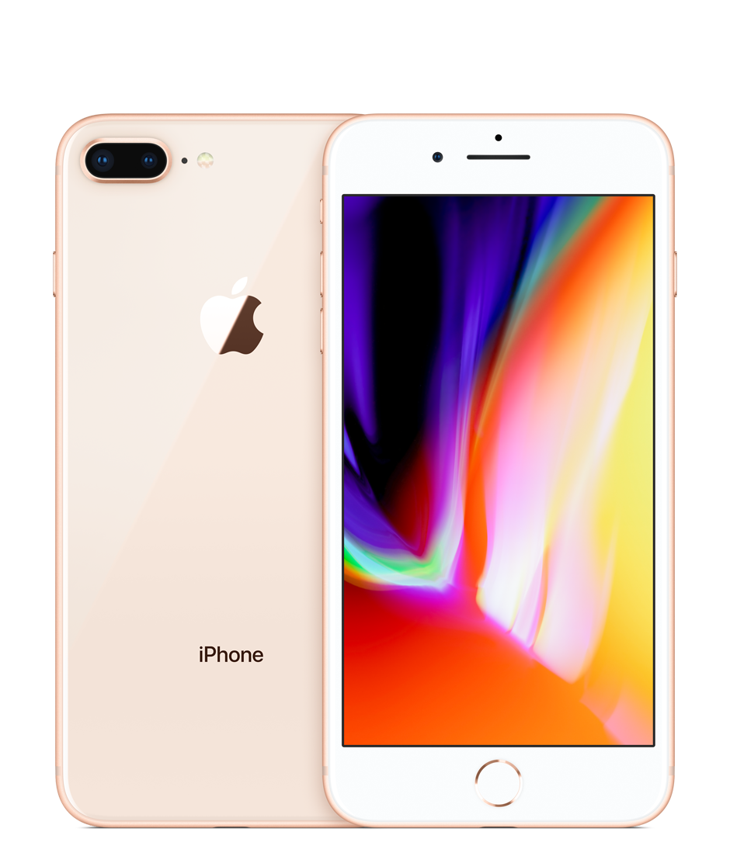
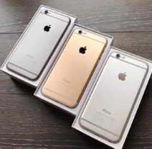


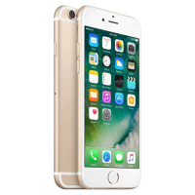
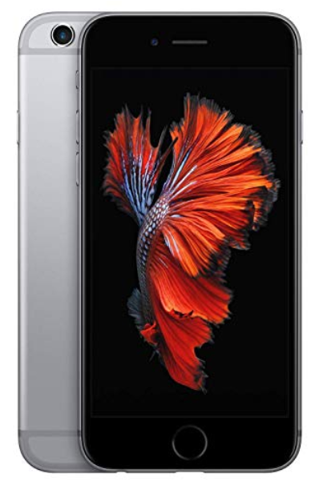


Search Item
Php 15,000
Php 12,000
Php 20,000
Php 14,500

Slide 4

Search Item
Php 15,000
Purchase Item

Slide 5

Search Item
Php 12,000
Purchase Item

Slide 6
Search Item
Php 20,000
Purchase Item

Slide 7
Search Item
Php 14,500
Purchase Item

Slide 8
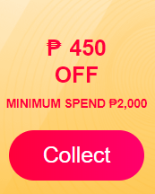
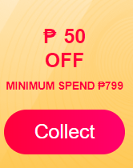
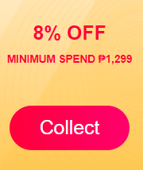
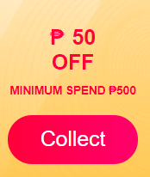
Lazada

Slide 9

Search Item
Php 15,000
Would you like to check if there are available vouchers?
Yes
No
Purchase Item

Slide 10
Search Item
Php 12,000
Would you like to check if there are available vouchers?
Yes
No
Purchase Item

Slide 11
Search Item
Php 20,000
Would you like to check if there are available vouchers?
Yes
No
Purchase Item

Slide 12
Search Item
Php 14,500
Would you like to check if there are available vouchers?
Yes
No
Purchase Item

Slide 13
Search Item
Php 15,000
This will take you to the item site.
Okay
Cancel
Purchase Item

Slide 14
Search Item
Php 12,000
This will take you to the item site.
Okay
Cancel
Purchase Item

Slide 15
Search Item
Php 20,000
This will take you to the item site.
Okay
Cancel
Purchase Item

Slide 16
Search Item
Php 14,500
This will take you to the item site.
Okay
Cancel
Purchase Item

Slide 17
Available Vouchers

Slide 18
Available Vouchers
Use Voucher

Slide 19
Available Vouchers
This will take you to the item site.
Okay
Cancel
Use Voucher

Slide 20
Lazada
Use Voucher

Slide 21
Lazada
This will take you to the item site.
Okay
Cancel
Use Voucher

